Slide 1

Technical Solutions

Slide 2
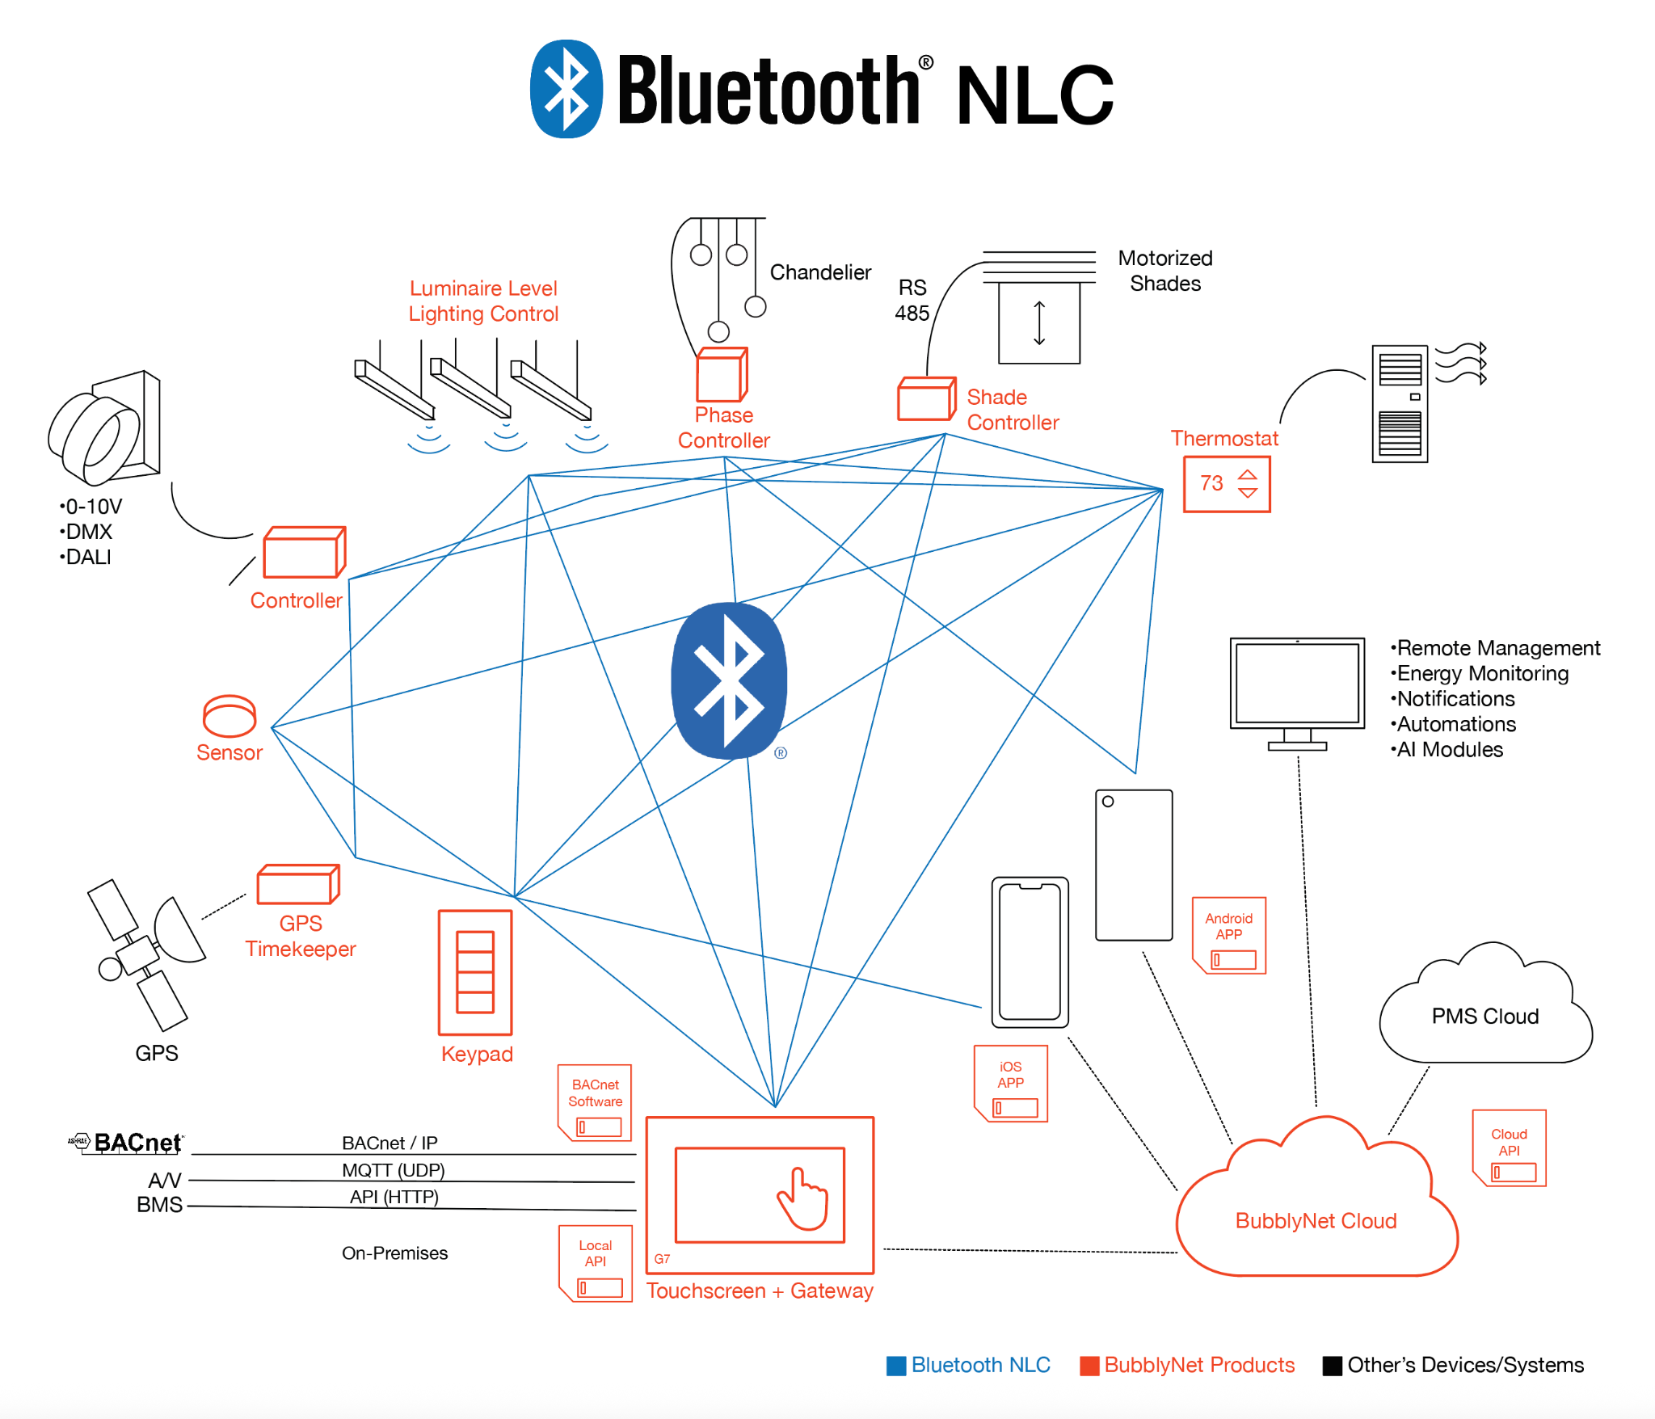
A Complete Solution

Slide 3
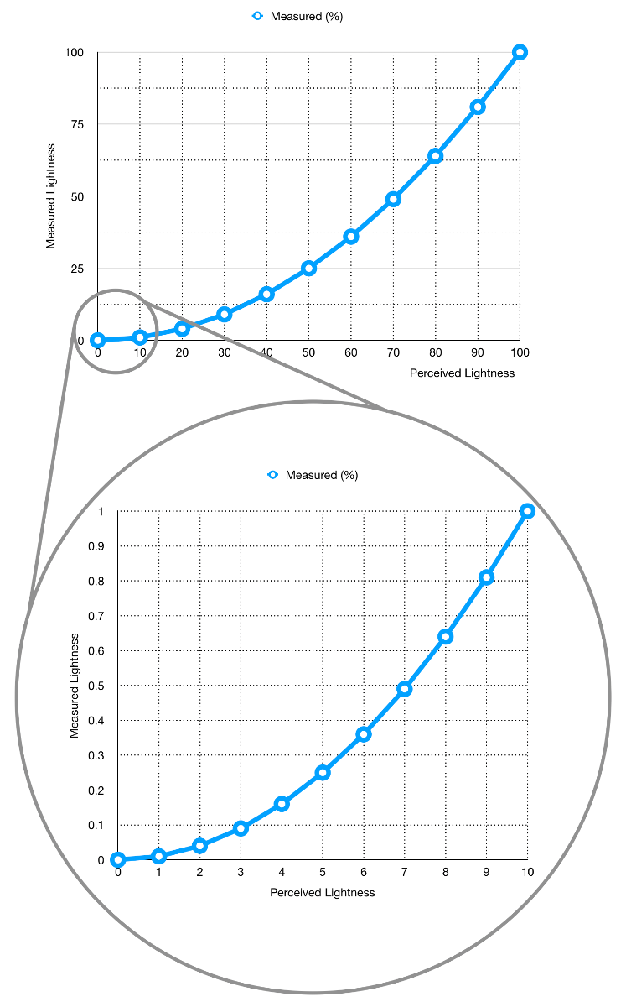
Dimming
BubblyNet uses Perceived Lightness as a scale (International Commission of Illumination and ISO recommendations).
As an example, 3% on a BubblyNet App dimmer corresponds to 0.09% power to the luminaire.
Here some parameters for personalized dimming:
Power Factor;
Low/High-end trim;
Linear/Logaritmic curves;
Programmable dimming curves;
PWM frequency;

Slide 4
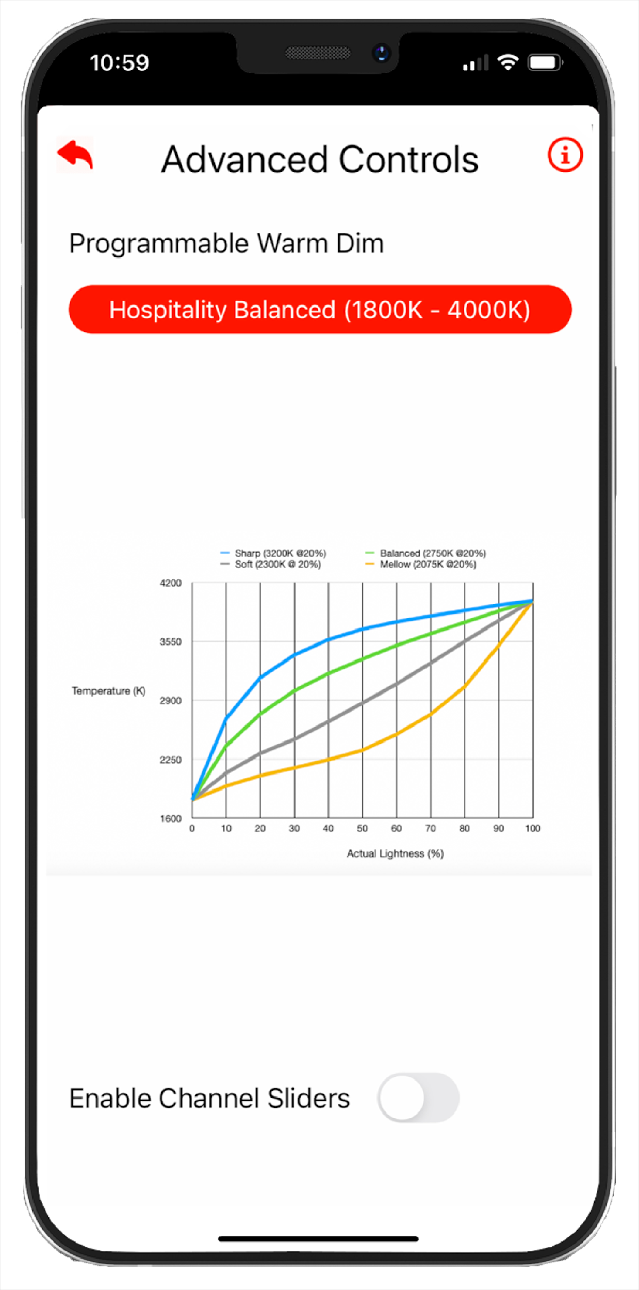

Warm Dim
Programmable Warm Dimming curves can be selected to achieve the intended effect with accuracy.
The Live-Slider function allows for instant changes while using the App.

Slide 5
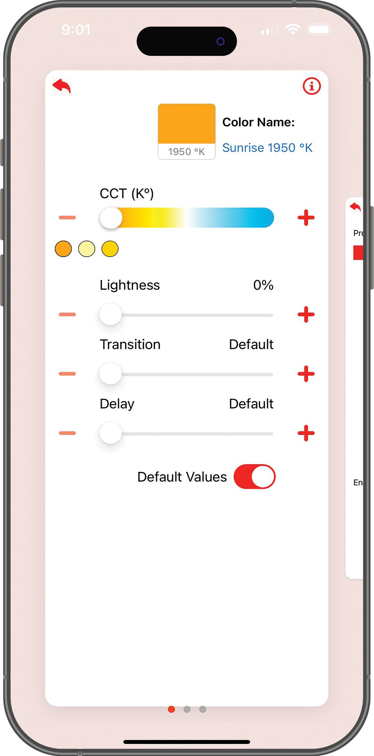
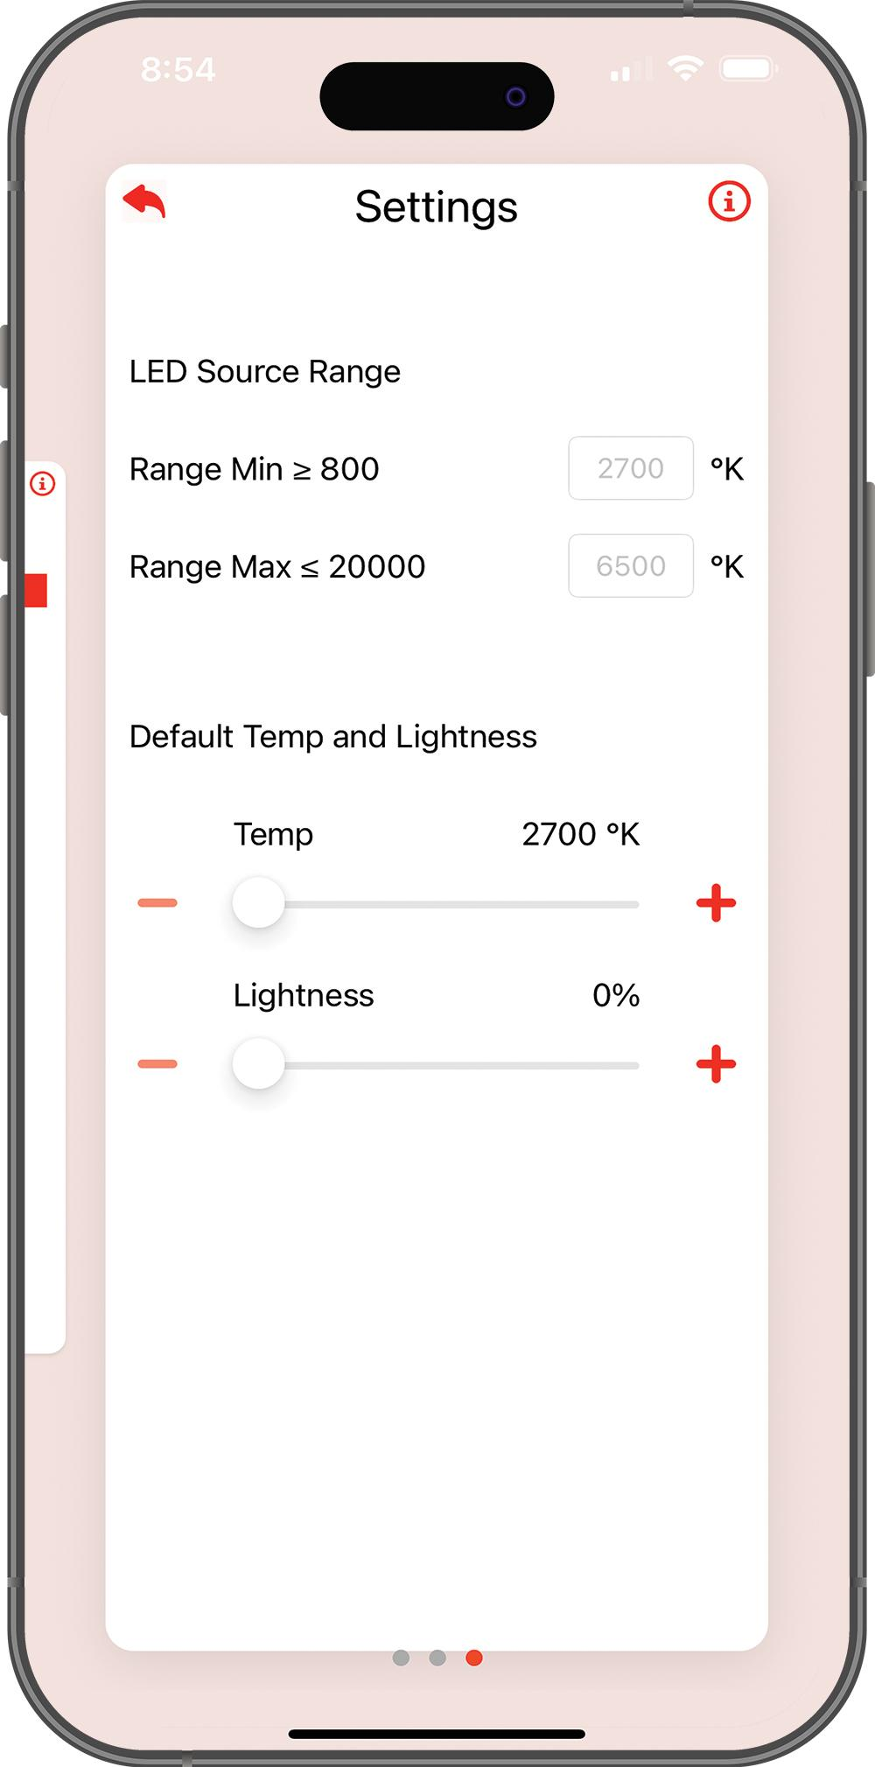
Tunable White
There are multiple settings allowing to synchronize multiple luminaires to the same CCT.
CCT levels can be selected with precision and recalled across all functions and the whole project

Slide 6
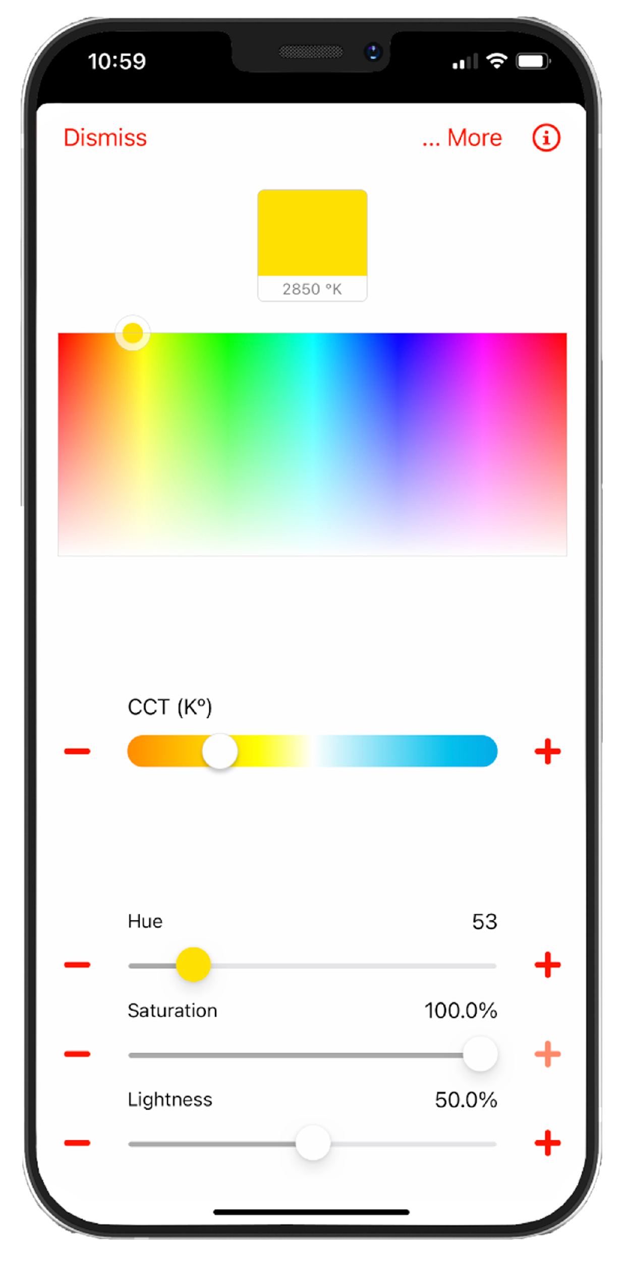
RGBW
Colors can be selected with sliders, color pallet, by Hex code or CCT level.
Accuracy of color is obtained by selecting the RGBW chip used in the luminaire.

Slide 7
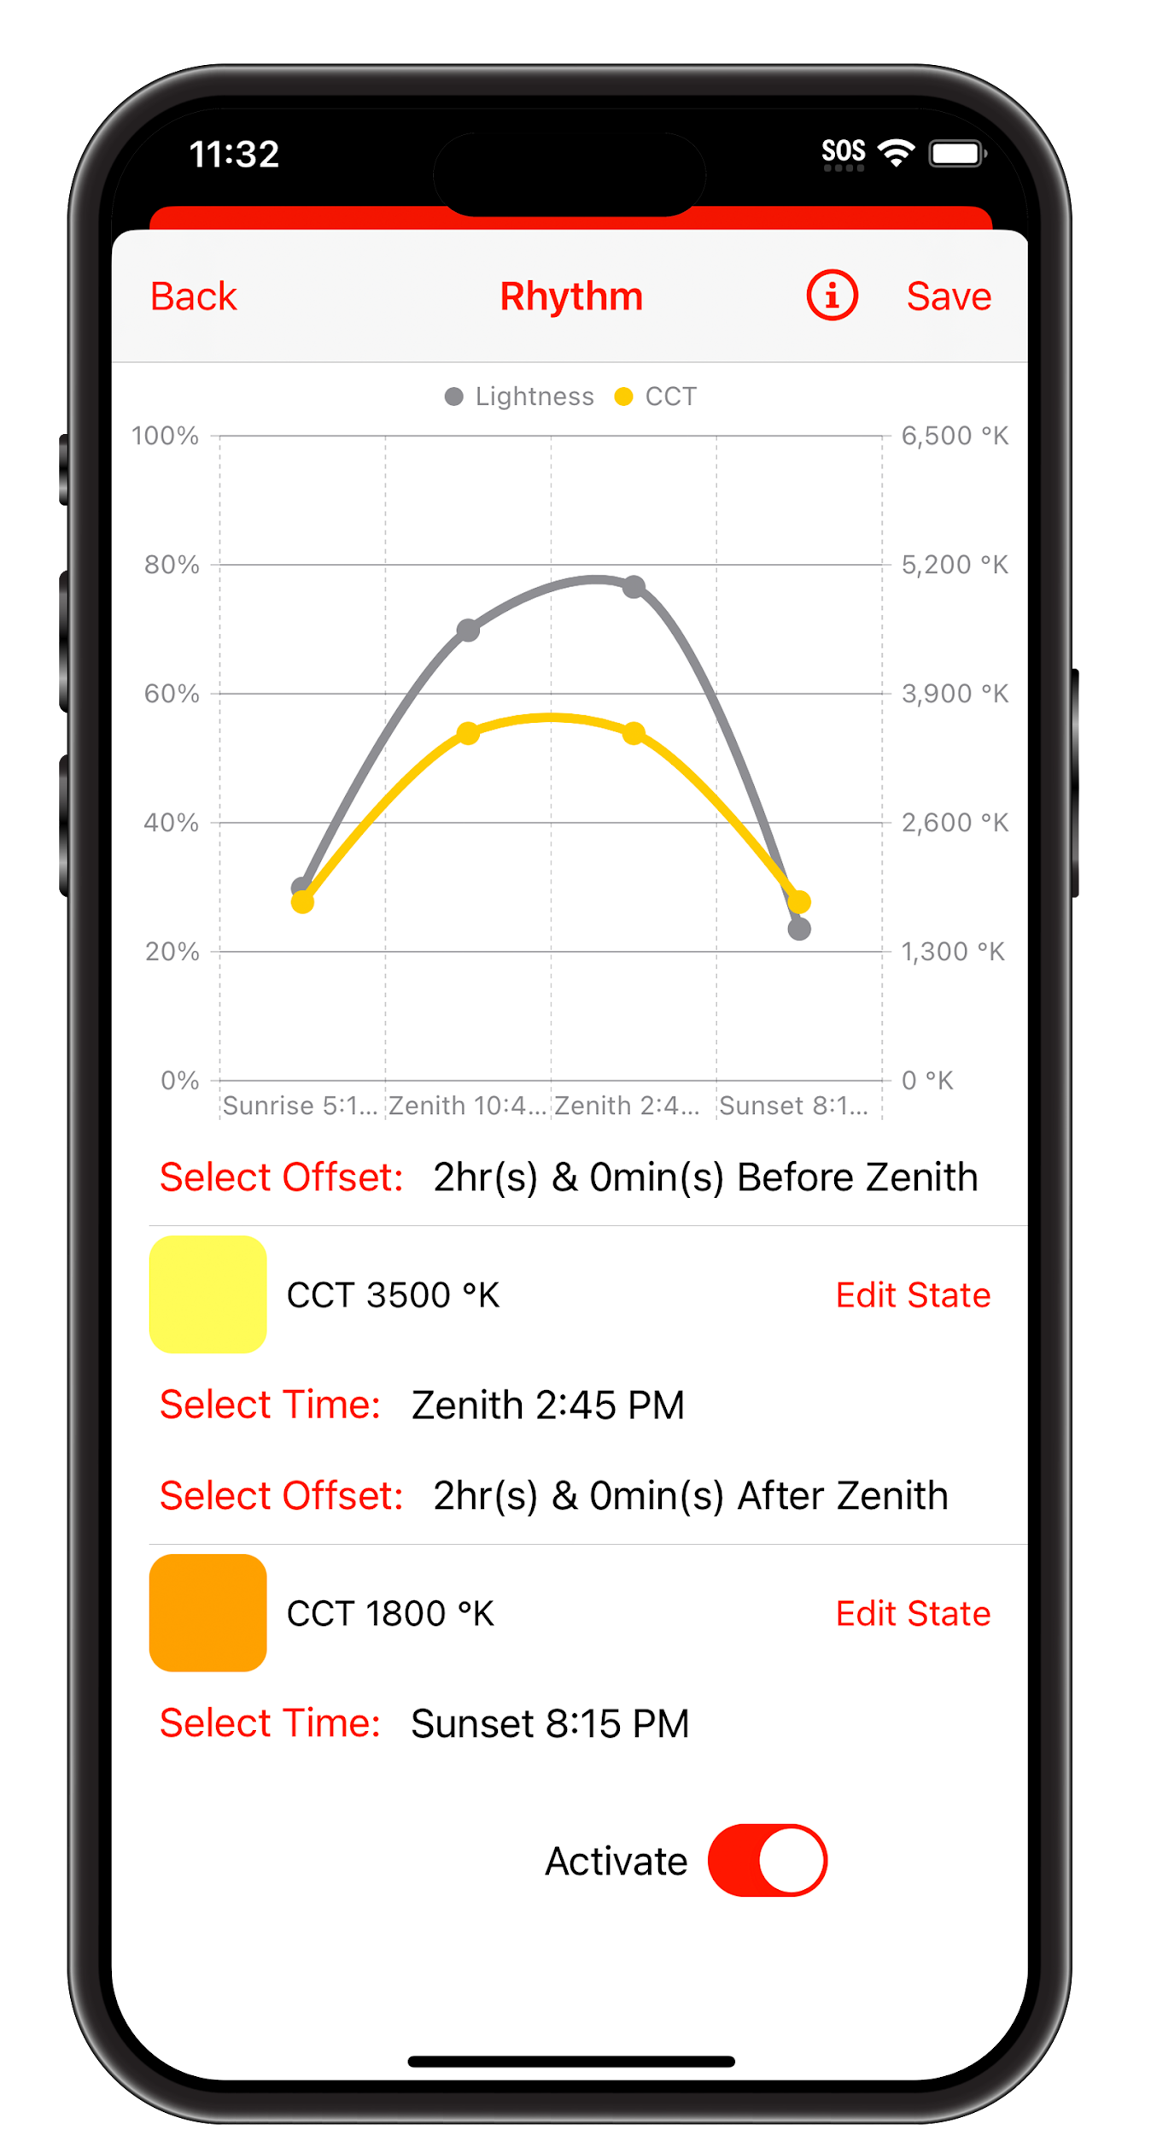
Circadian
Circadian Rhythm can be programmed through the app and synchronized with sunrise/zenith/sunset times for a unique experience every day of the year.

Slide 8
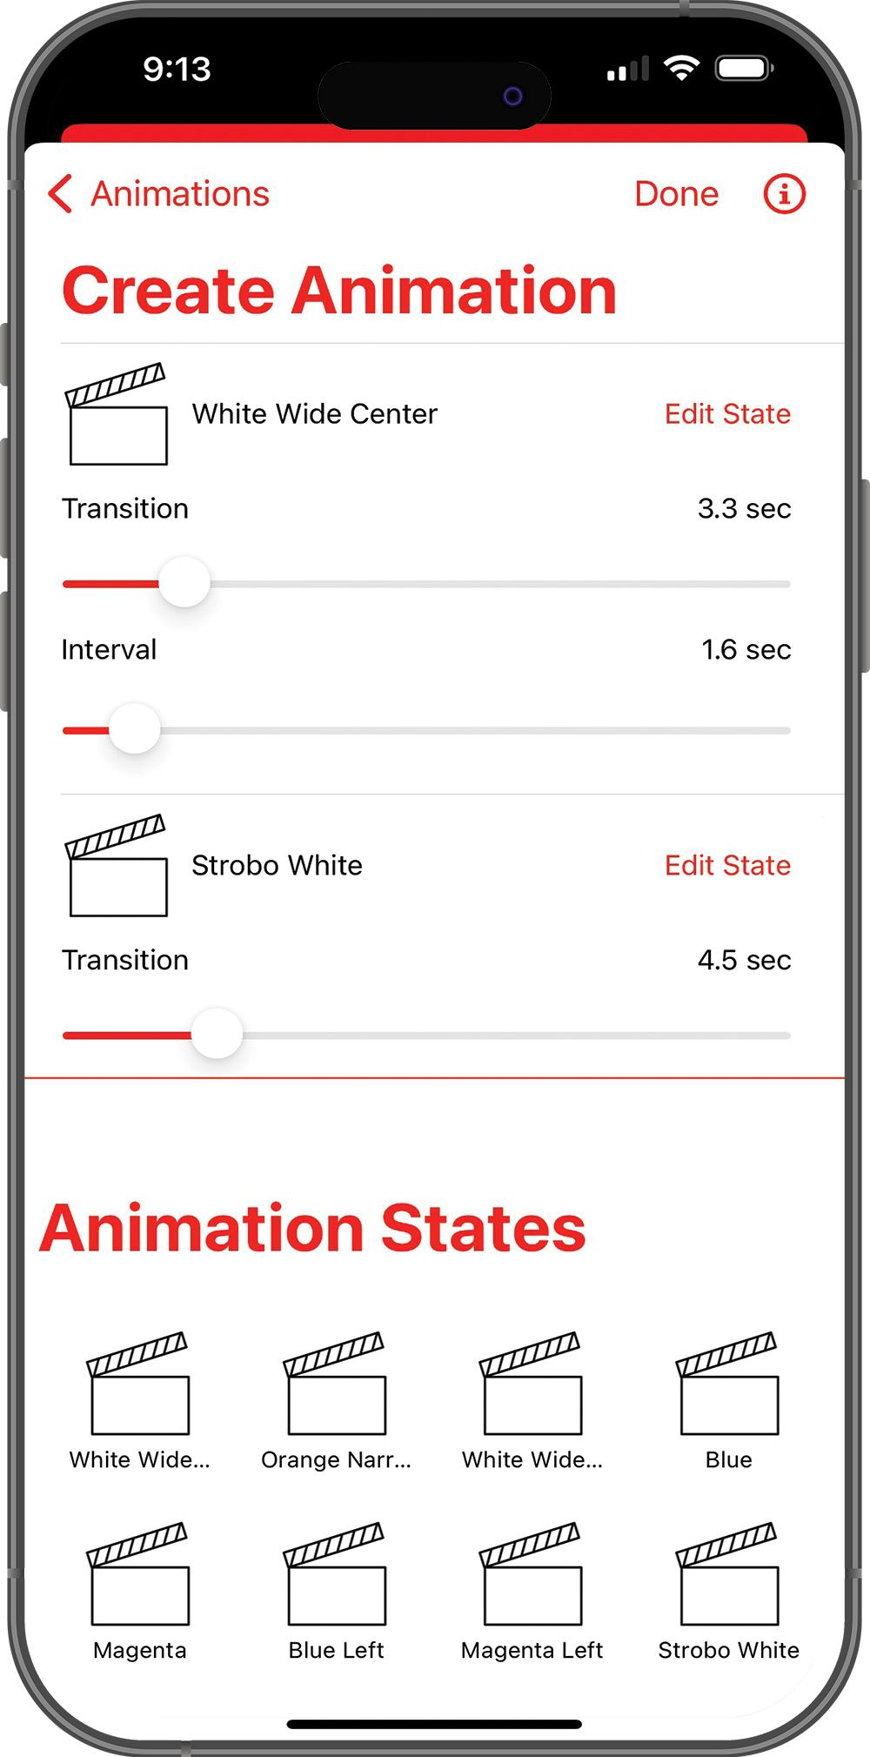
Animations
Animations can be created selecting colors, intensities or scenes and programming the transitions though multiple luminaires.
Animations with DMX controllers include functions such as pan/tilt, zoom and strobe as well as water and smoke features and more.

Slide 9
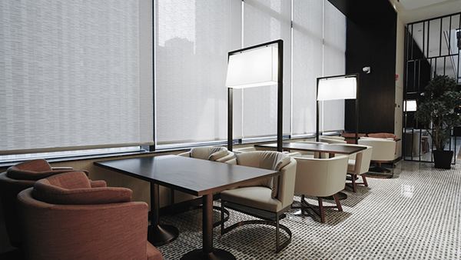
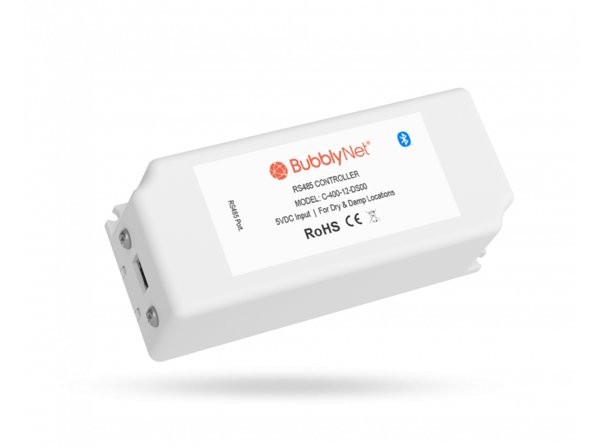
Shades Control
Shades and curtains of many brands can be controlled by switches, triggered by sensors and be part of scenes recalled by schedules.

Slide 10
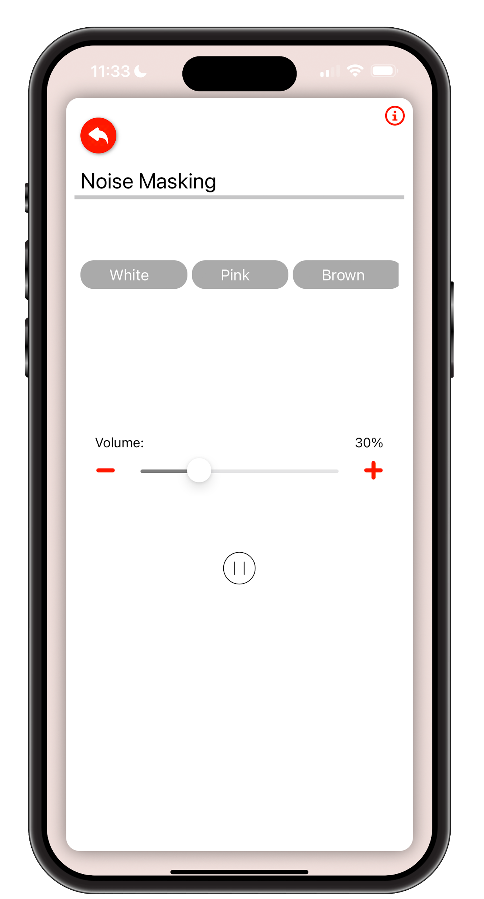
Sound Masking
BubblyNet controls all the well-being factors of the environment, which includes masking acoustic distractions and returning focus to what was the intended function of the space.

Slide 11
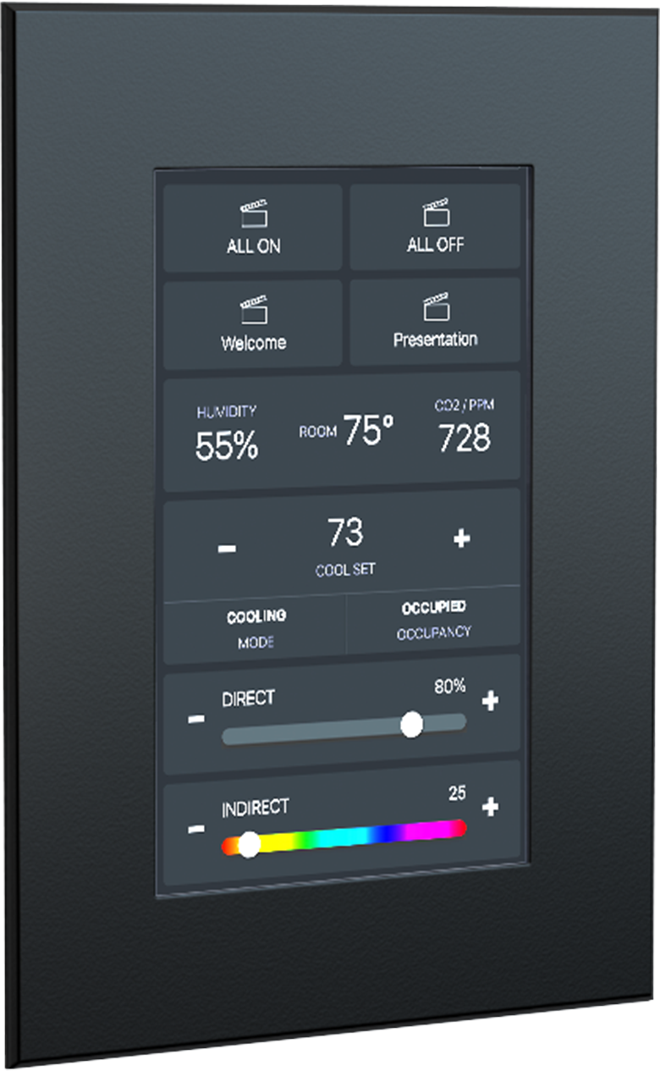
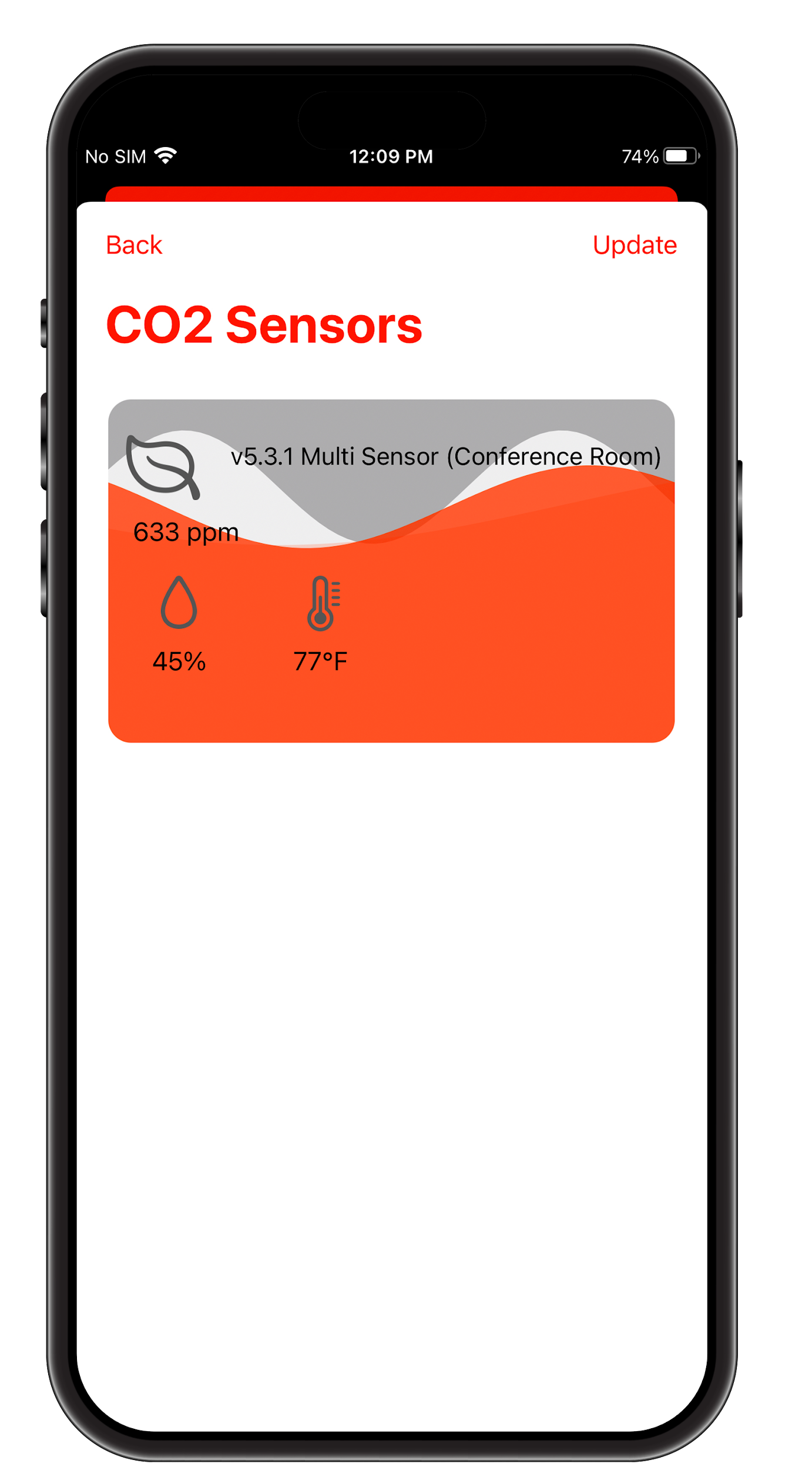
Internal Air Quality
CO2 levels as well as temperature and humidity are key to the well-being of guests and staff. Internal Air Quality can be monitored and controlled via BACnet/IP.

