Slide 1


Slide 2

BubblyNet is a smart building open platform which delivers wellbeing and sustainability by controlling all functions of the building such as lighting, shades, air quality and sound masking.

Slide 3




















It is based on open protocol Bluetooth Mesh/NLC, the world’s #1 low-power wireless standard.

Slide 4
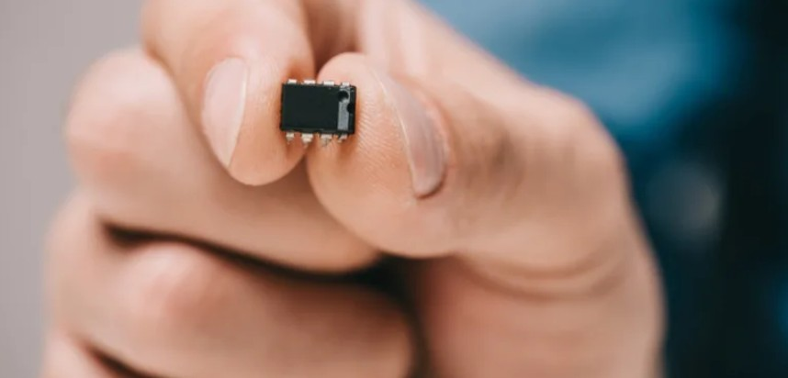
By embedding a tiny, but powerful, Bluetooth microchip
in every device (driver, controller, sensor, and switch), devices become intelligent and self-sufficient.
Every device has all the software instructions (as groups, clock, schedules, scenes, transitions) it needs to operate autonomously or in coordination with other devices.

Slide 5
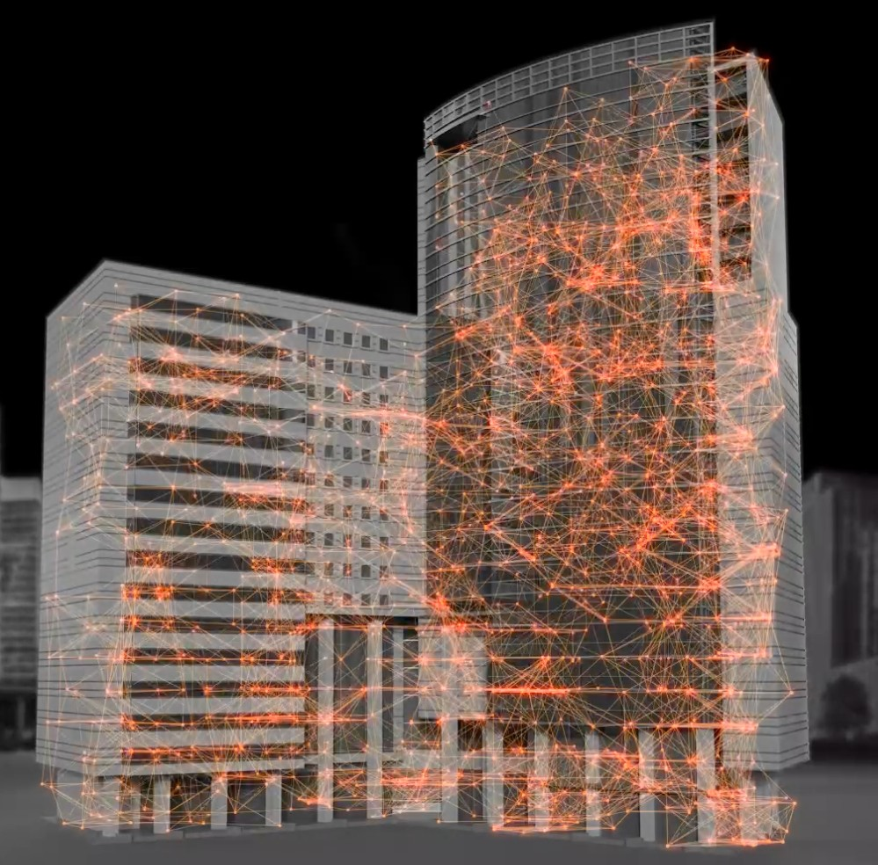
Devices, re-broadcasting messages, create a Mesh network which eliminates the need for control infrastructure even for very large projects.
with some unique benefits
.

Slide 6

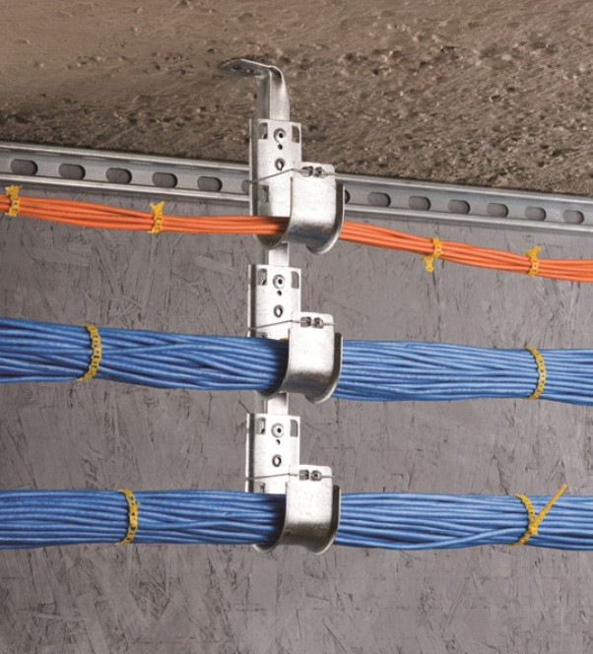
Simplification
A Bluetooth Mesh network doesn’t require control cables resulting in substantial labor savings.

Slide 7
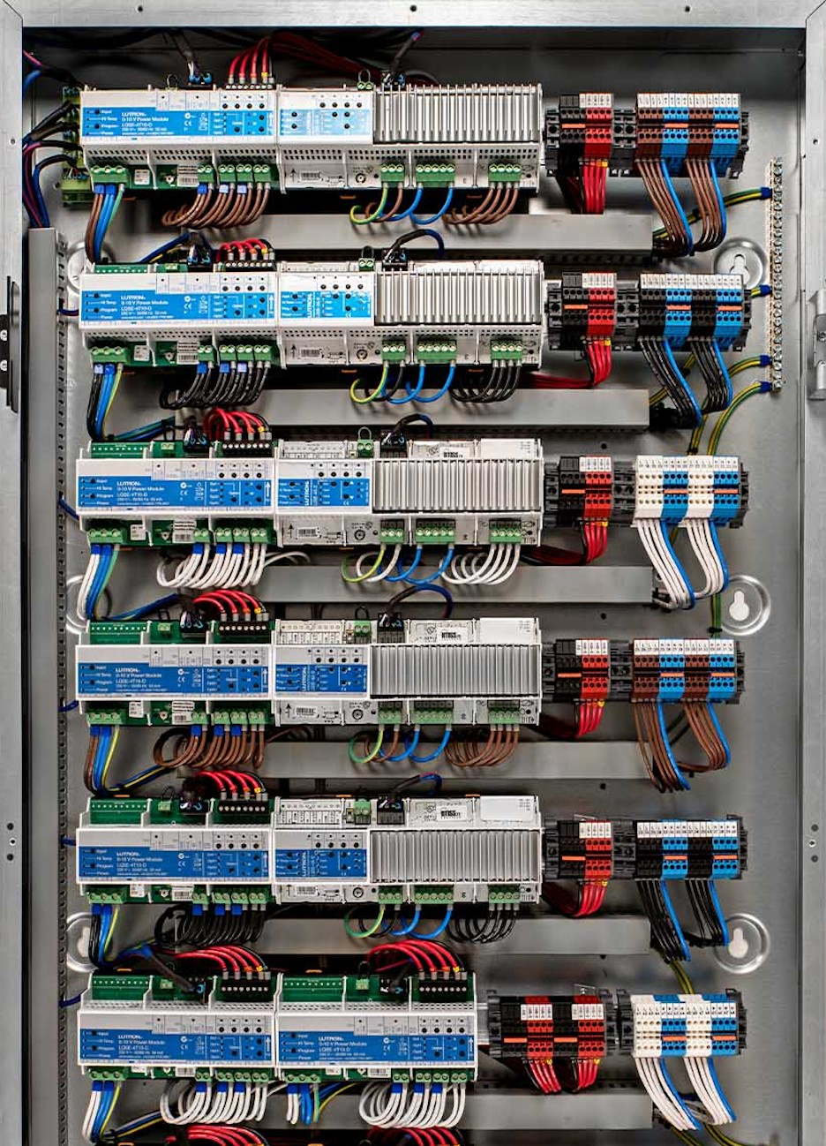

Simplification
A Bluetooth Mesh network doesn’t require additional control hardware. The design of the system is quick and simple and the BOM substantially reduced.

Slide 8
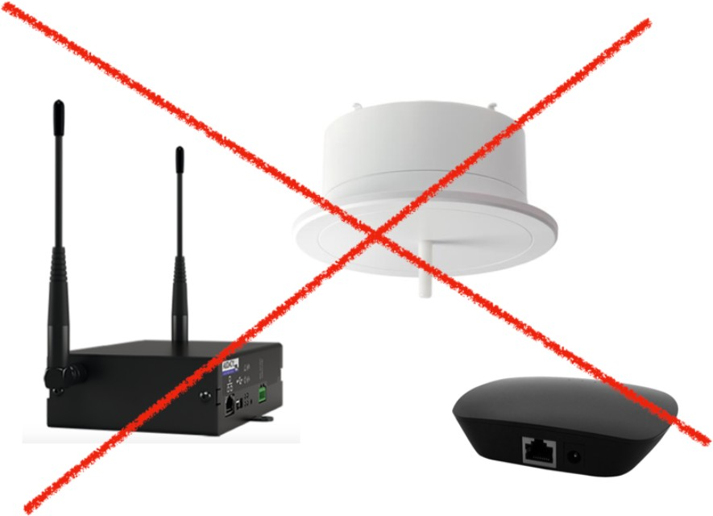


Simplification
A Bluetooth Mesh network doesn’t require hubs and similar single-point-of-failure.
Nor does it require Internet or WiFi to operate.

Slide 9
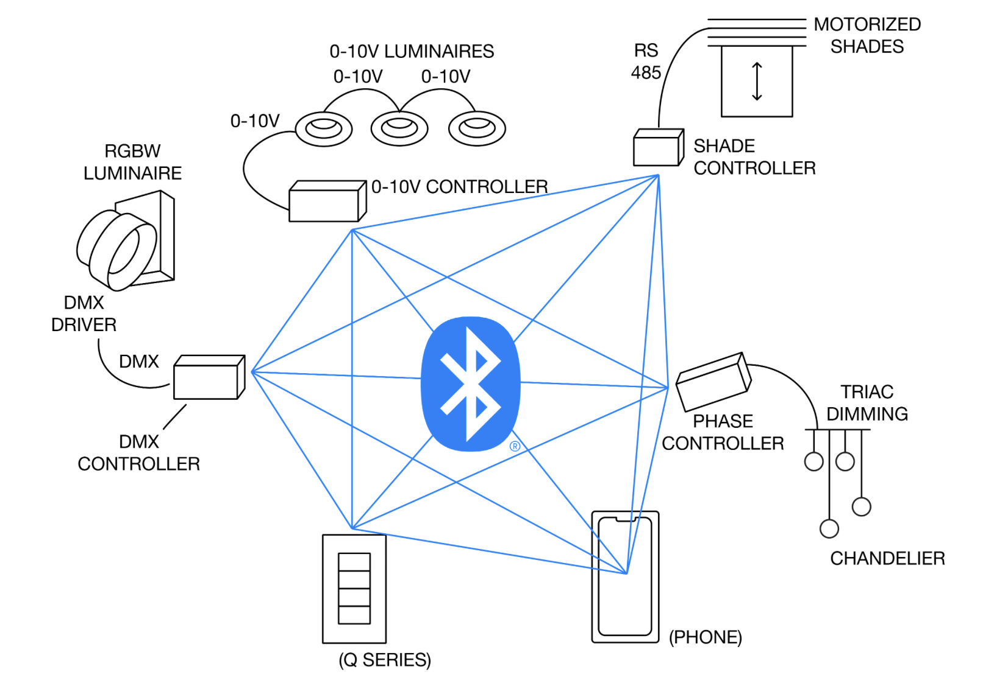
Controllers
Any load can be controlled, either single addressing luminaires as well as per zones:
0-10V 1 channel & 2 channels
Forward Phase
Reverse Phase
Shades
DMX
DALI
Sensors
Beam Shaper
Dry Contact

Slide 10
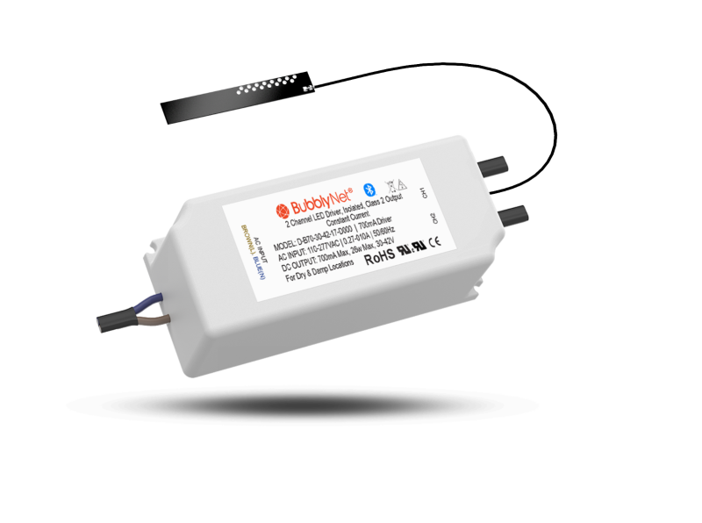
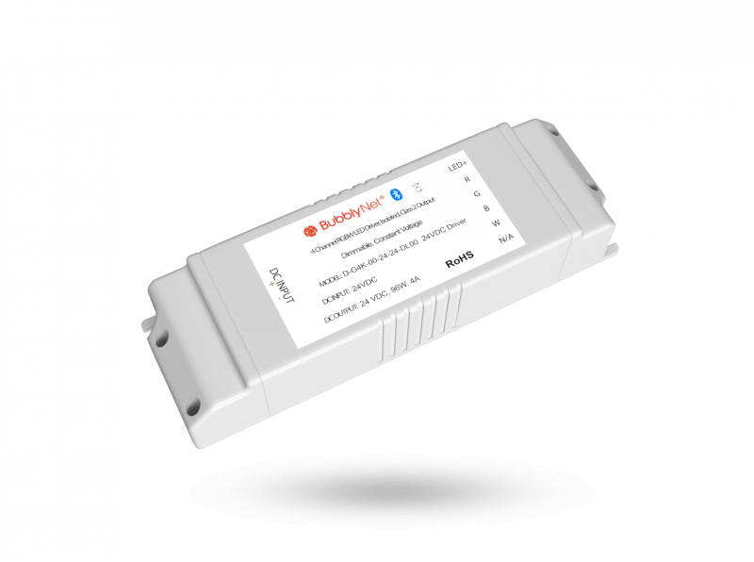
Drivers
On-board drivers can also be used:
Constant current 1 channel
Constant current 2 channels
Constant current 4 channels
Constant voltage 1 channel
Constant voltage 2 channels
Constant voltage 4 channels

Slide 11
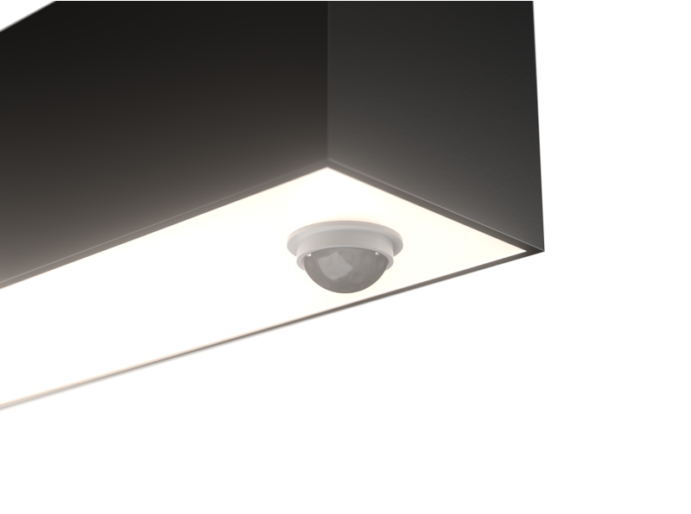
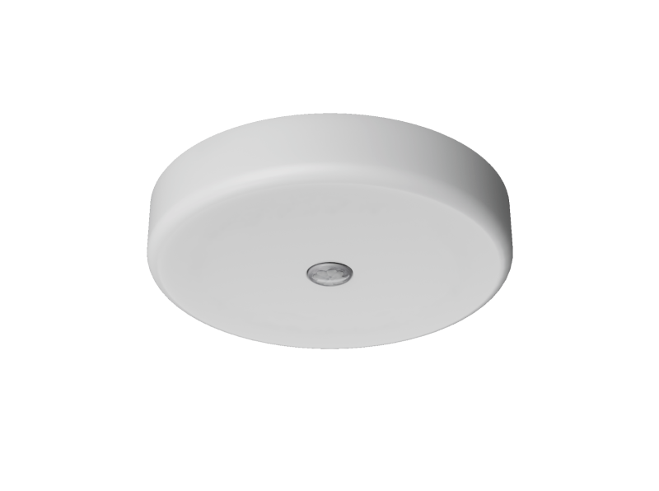
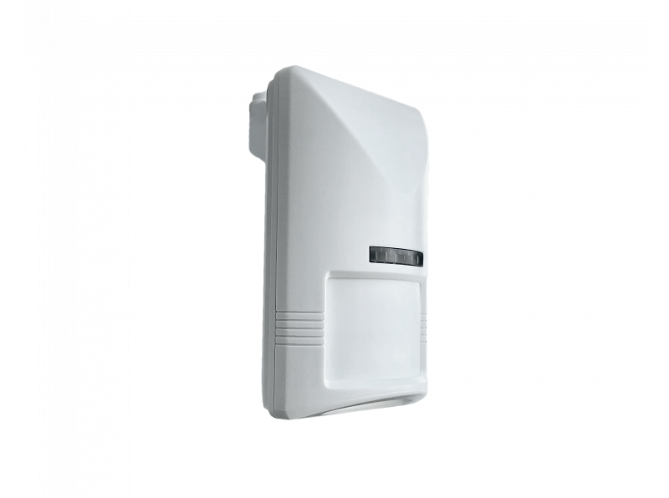
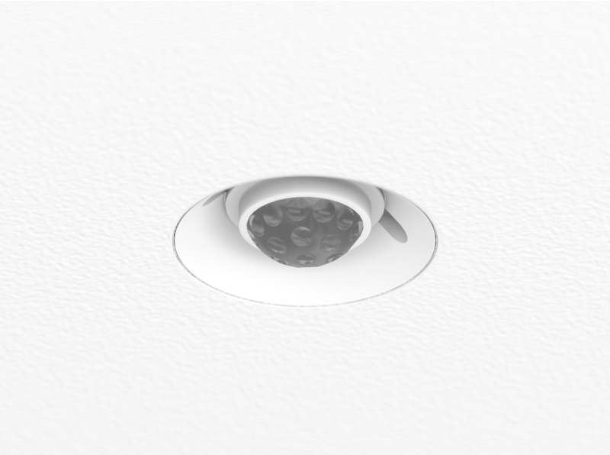
Sensors
A wide variety of sensors are available:
Low voltage/line voltage
Battery powered
PIR
Dual Tech
On-board luminaires
Ceiling recessed/surface
Wall mounted
Track mounted
High bay/low bay
Daylight
CO2
Contact sensor

Slide 12
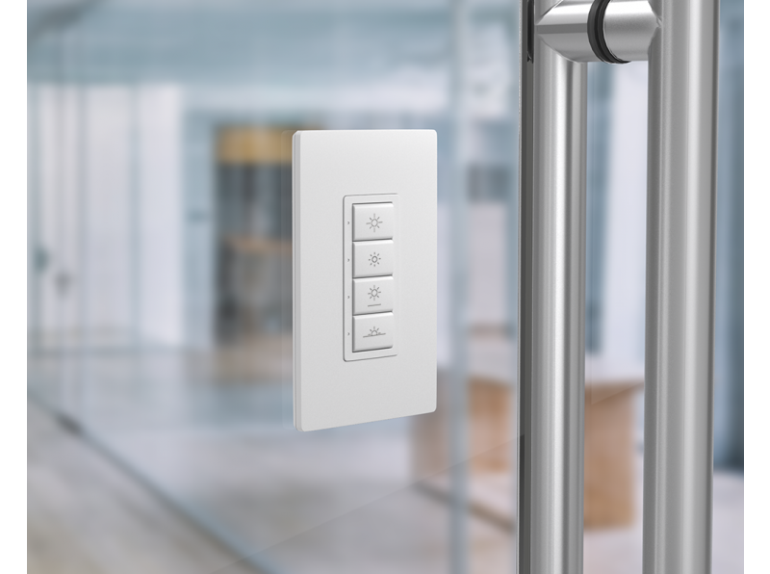
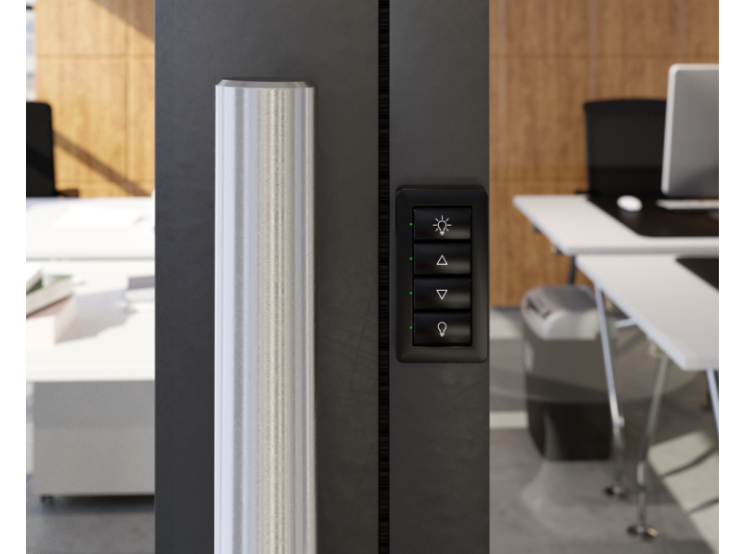
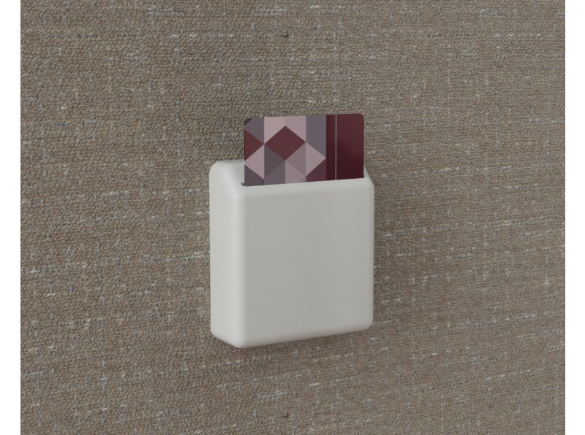
Switches
Switches can be wired as well as battery powered

Slide 13
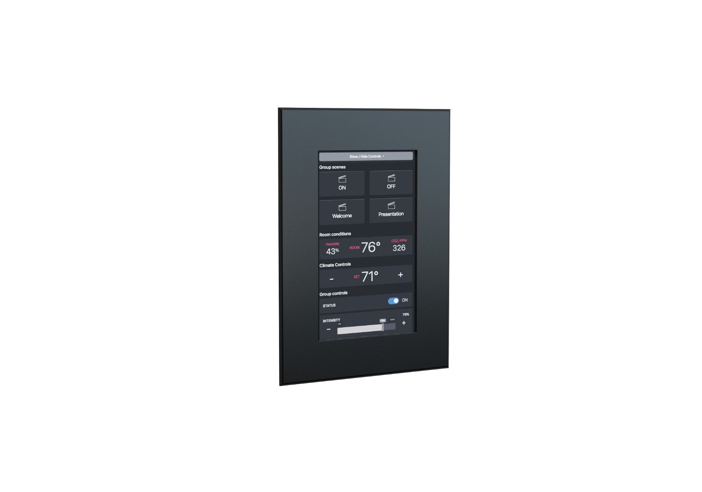
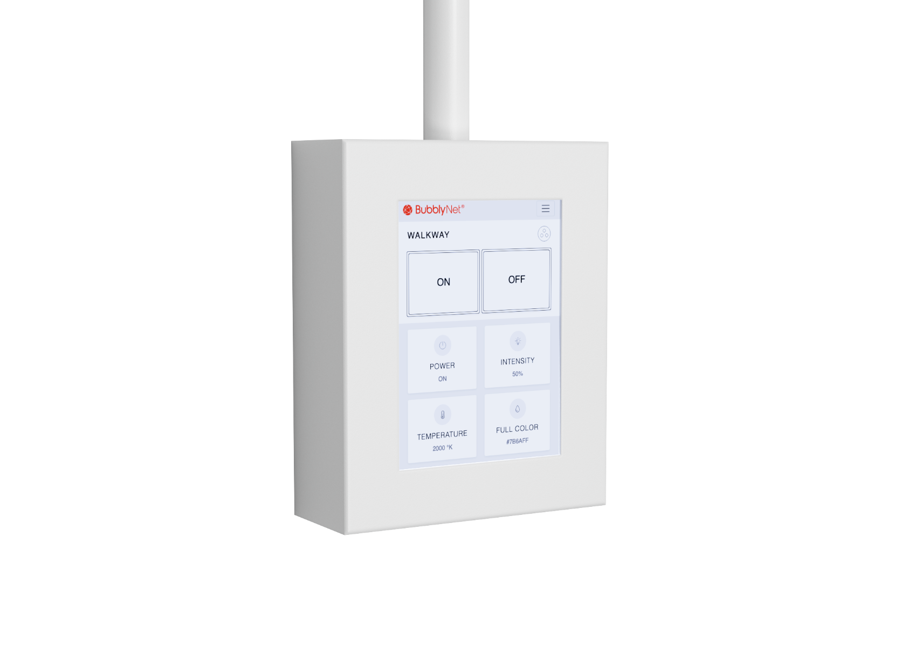
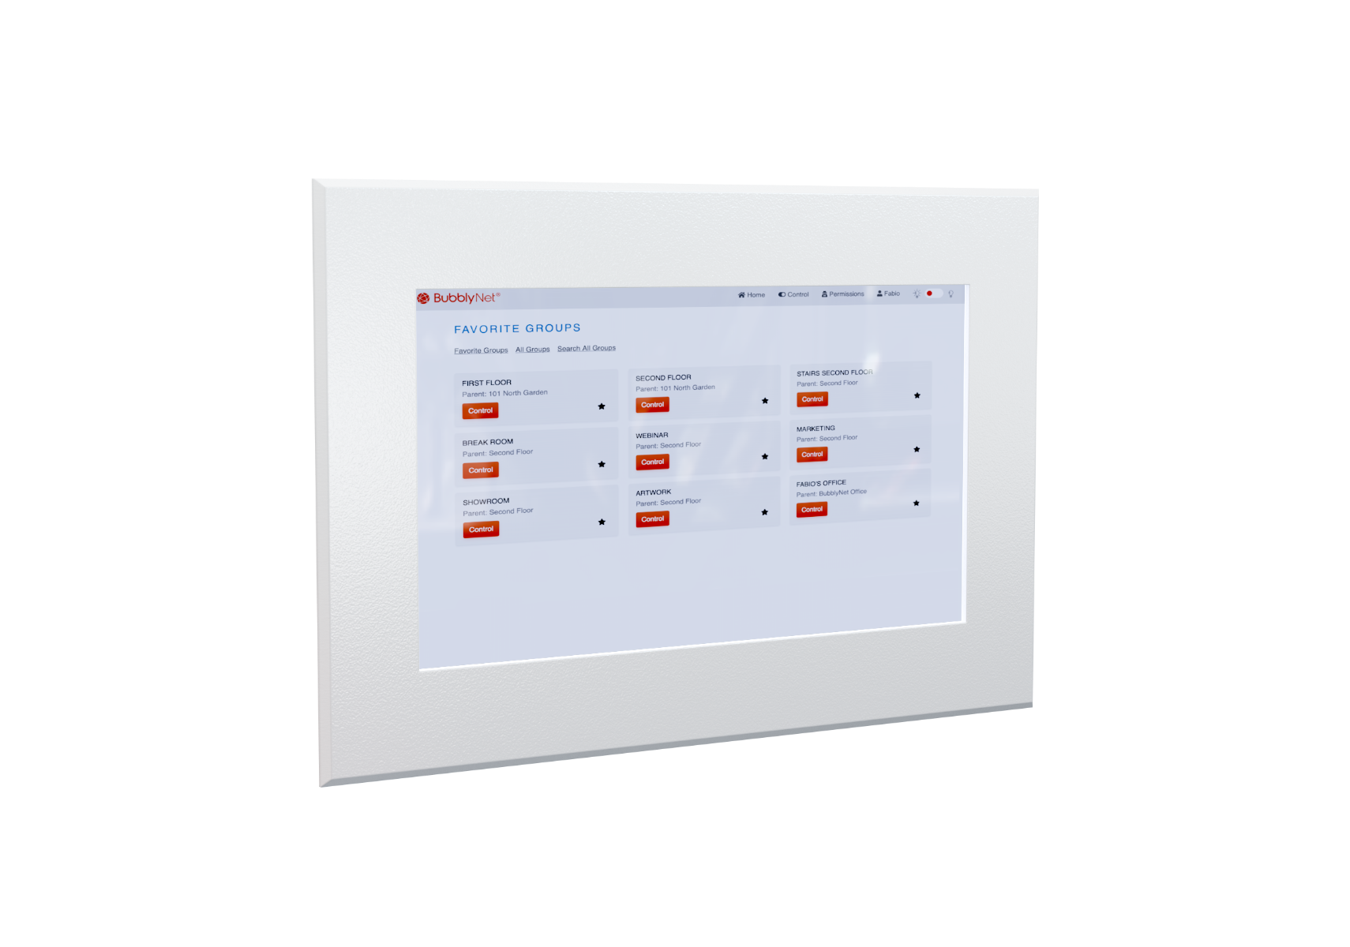
Touchscreens
Touchscreens can be local-only as well as cloud-connected

Slide 14
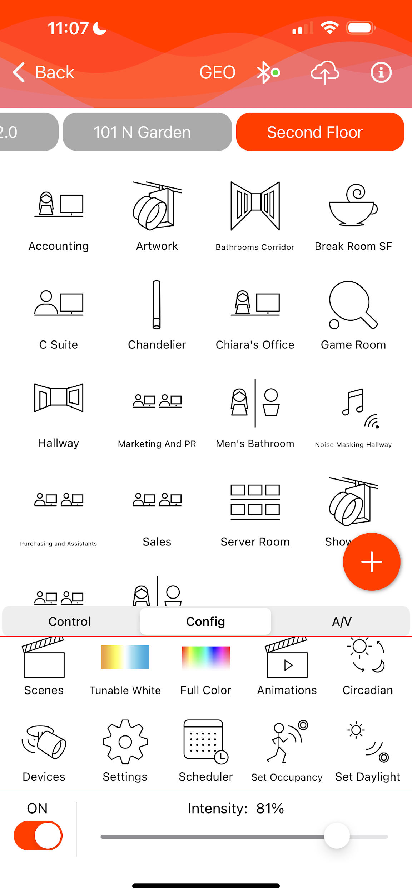
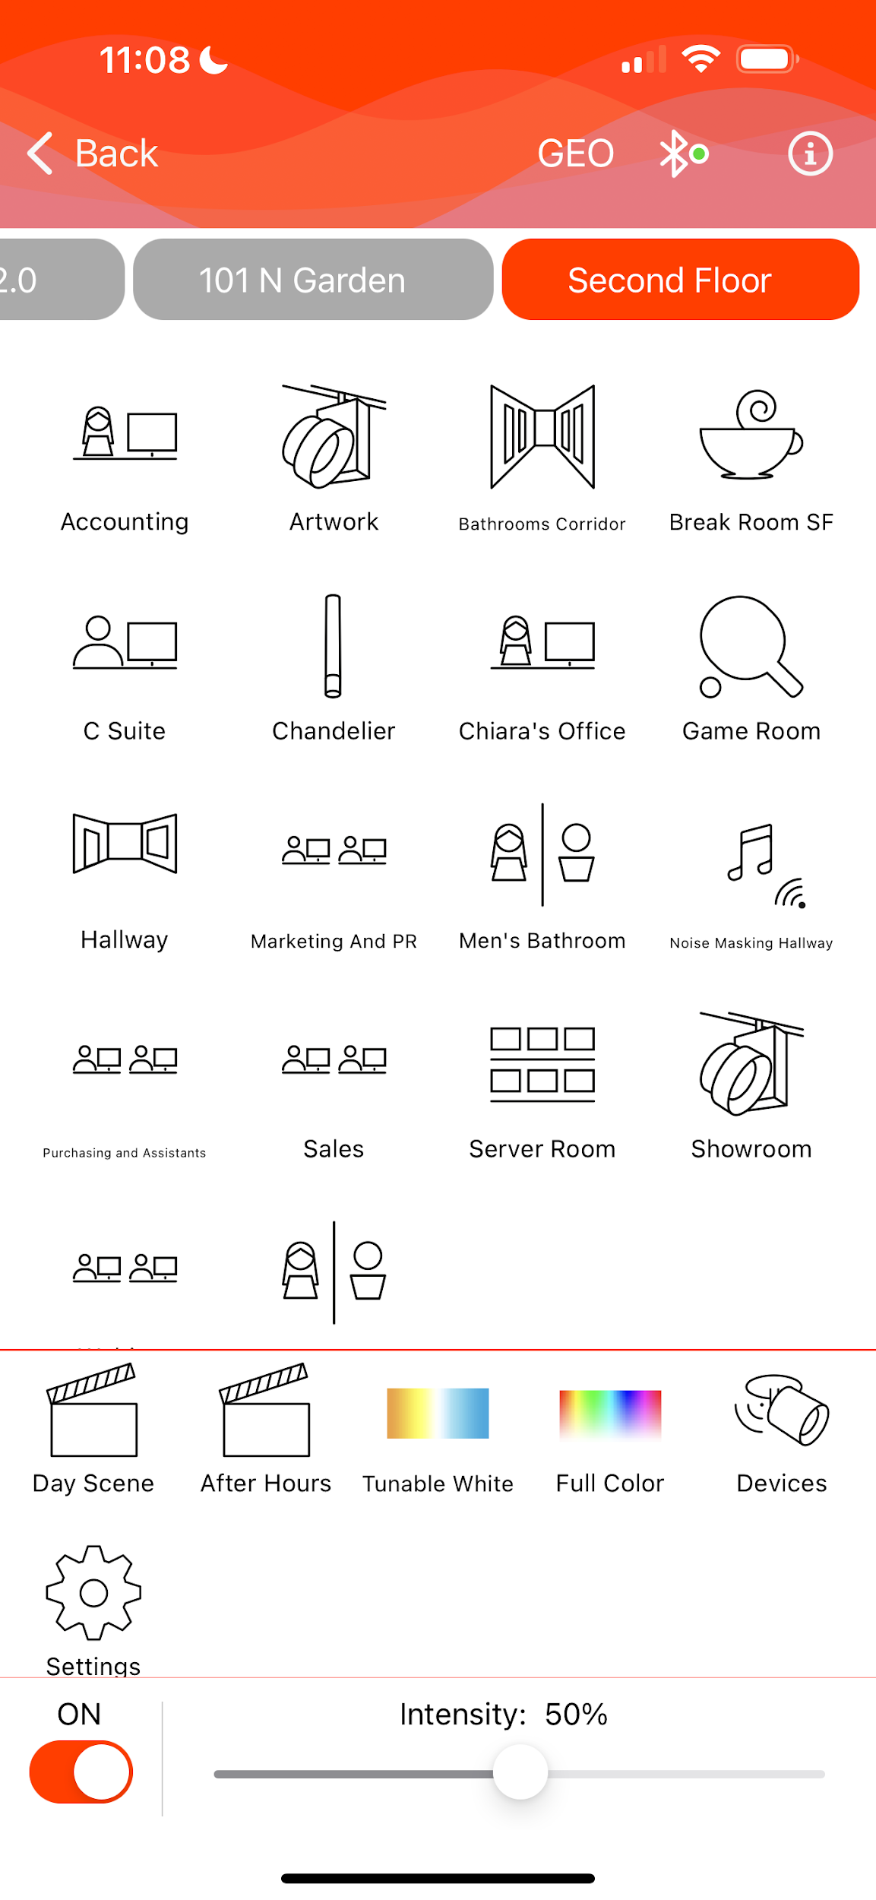
App
The App is very simple to use and available for Android and iPhone.
It can be used by the contractor to commission the job
as well as by the end-user to control the network

Slide 15
Integration
Integration with HVAC, BMS and other systems is possible through:
Dry contact;
RS485;
DMX;
BACnet over IP;
Local APIs;
Cloud APIs.

Slide 16
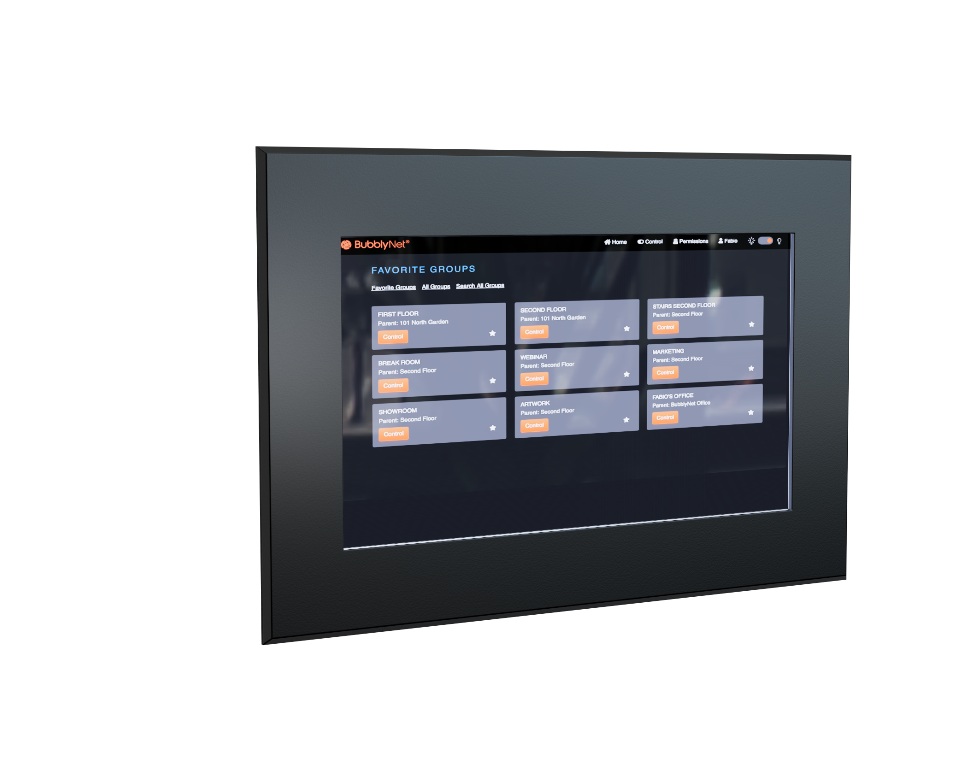
Cloud services
A full set of cloud services are available by adding a Gateway or a G-series Touchscreen to the project:
Remote control;
User Management;
Site map visualization & control;
Touchscreen configuration;
Notifications & network health control;
Multi-site aggregation.

Slide 17
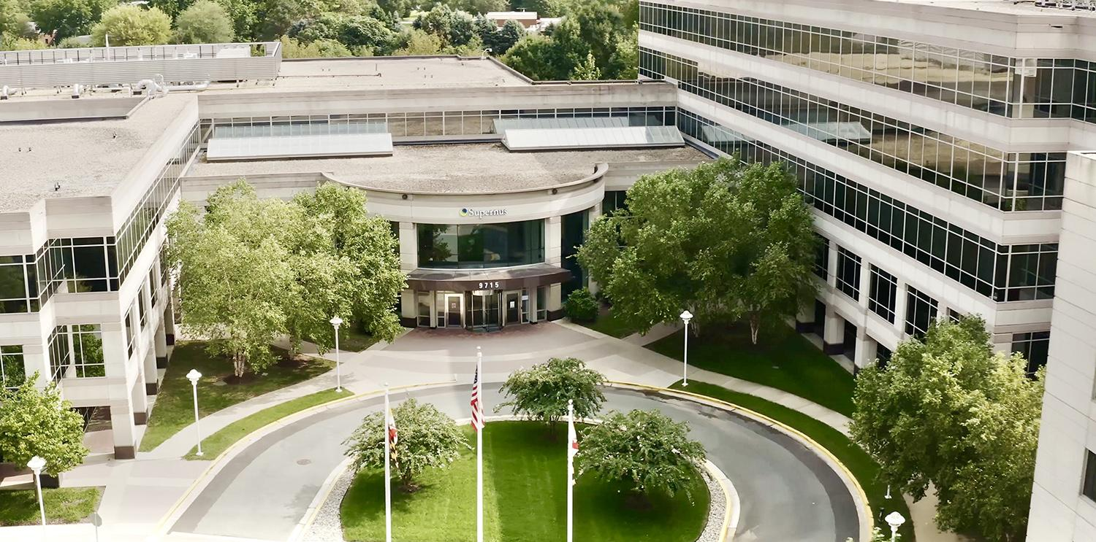
Easy to scale for large projects
Supernus Pharmaceuticals - Rockville, MD. 120,000 sq.ft, 1,500 BubblyNet devices

Slide 18
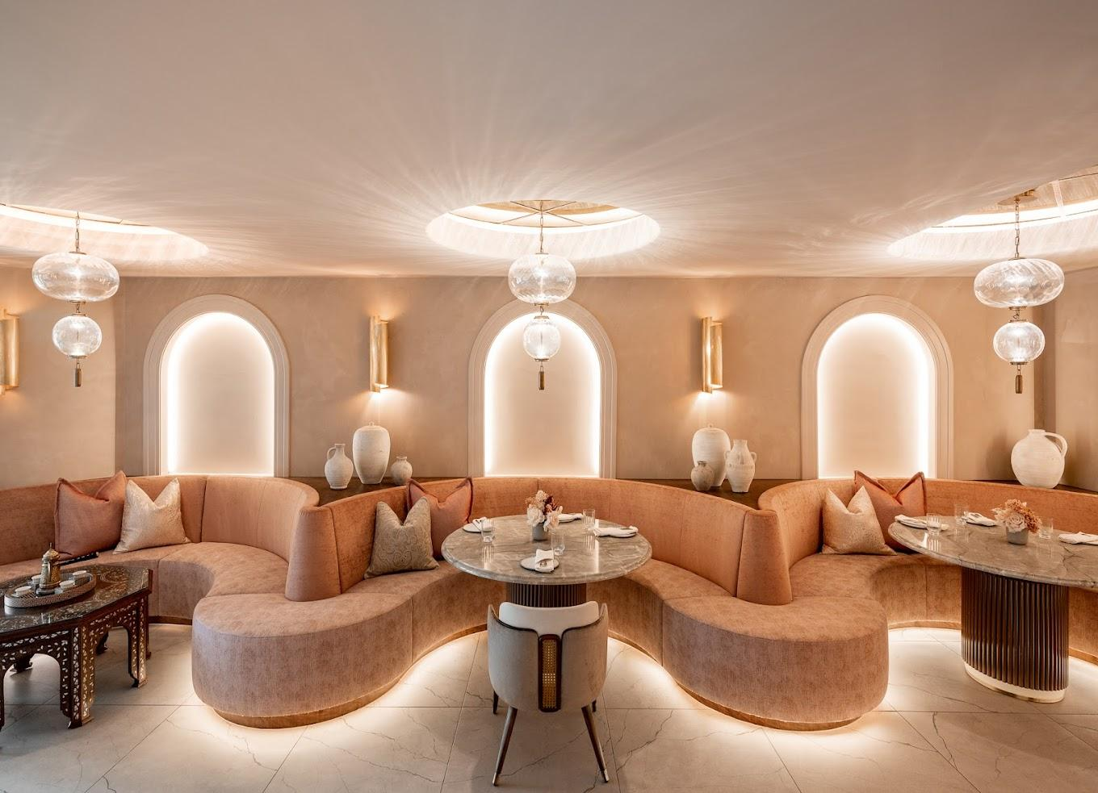
Professional settings for high-end lighting design
Ammoora - Baltimore, MD Variety of loads and dimming protocols

Slide 19
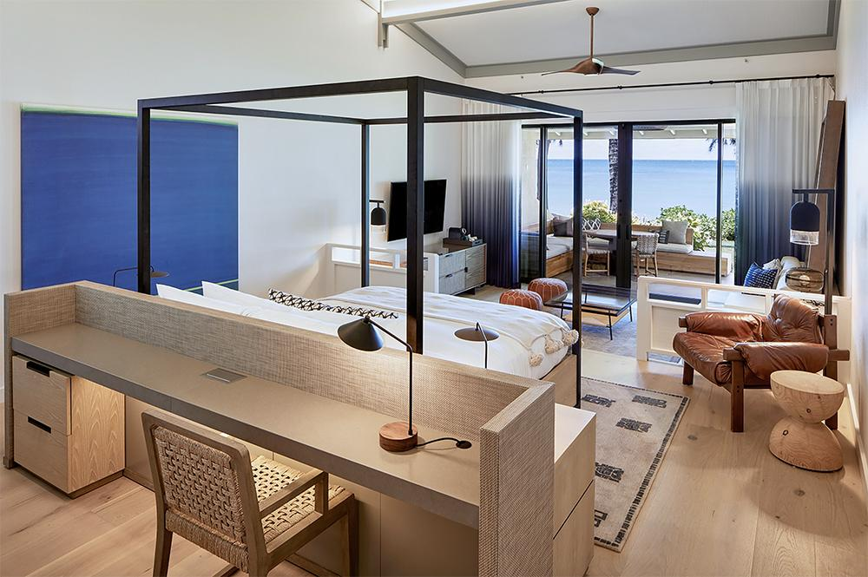
Cloud connectivity for Multi-site projects
Ritz-Carlton O’ahu - Turtle Bay 7 buildings, 1,200 BubblyNet devices

Slide 20

Air-gap encrypted networks for federal buildings
SeaTac Airport - Seattle, WA High security requirements

Slide 21
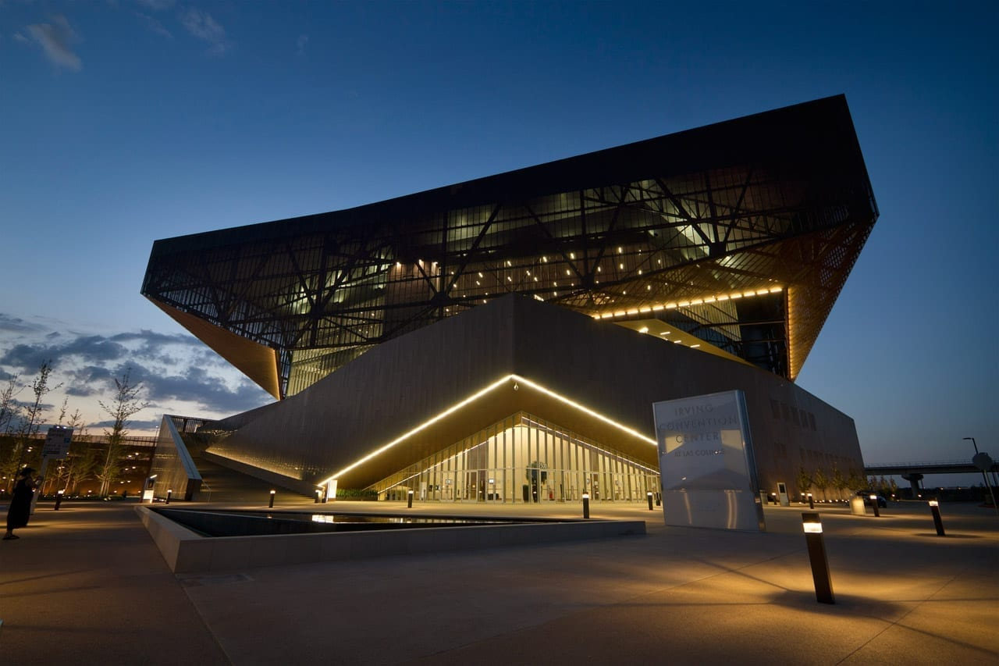
Award winning innovation for complex lighting
Irving Convention Center - Irving, TX DMX multivendor integration

Slide 22
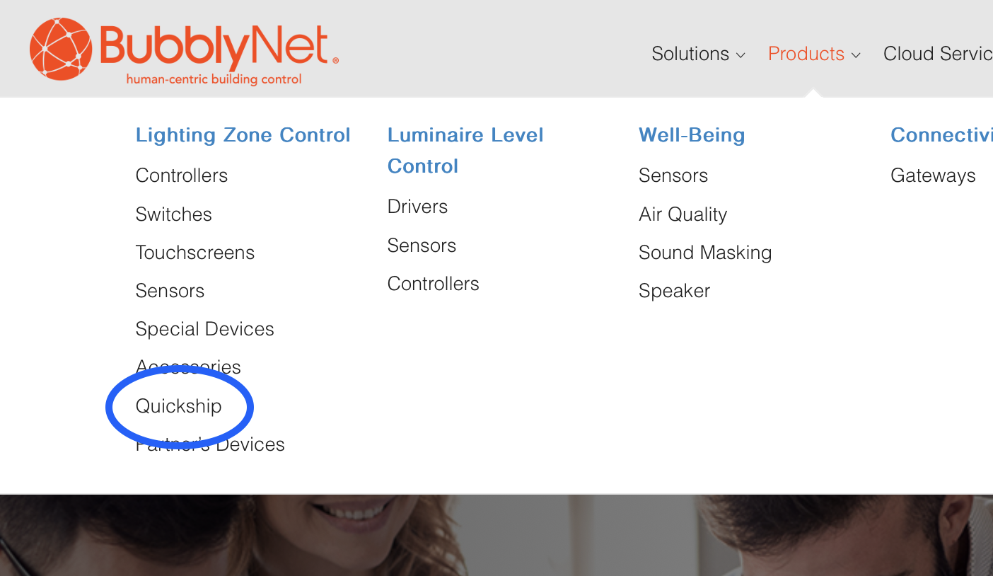
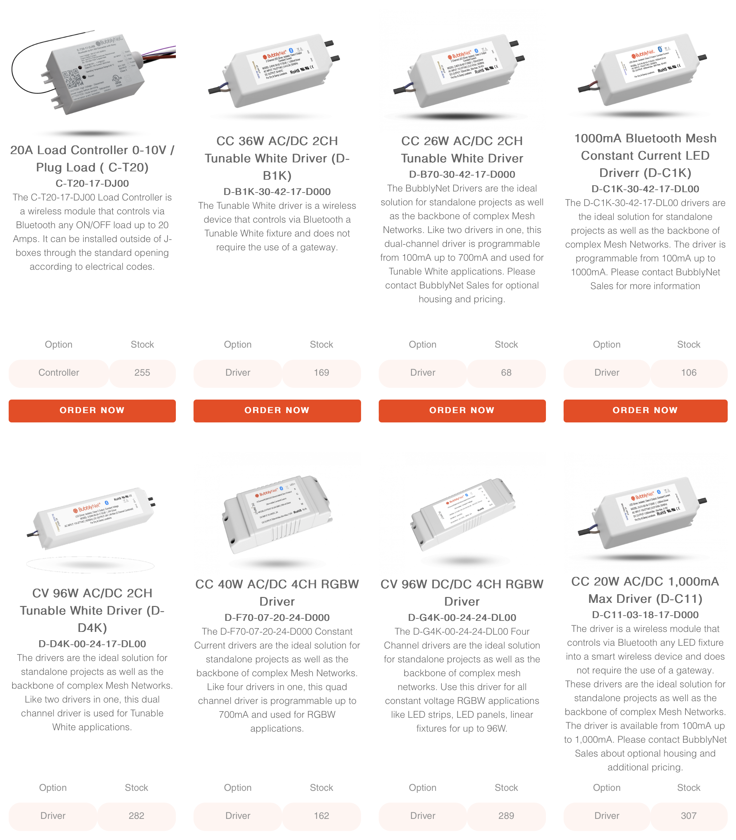
Deliveries
On-line Quick-Ship inventory for 5 business days delivery.
Standard delivery is 4 weeks.

Slide 23
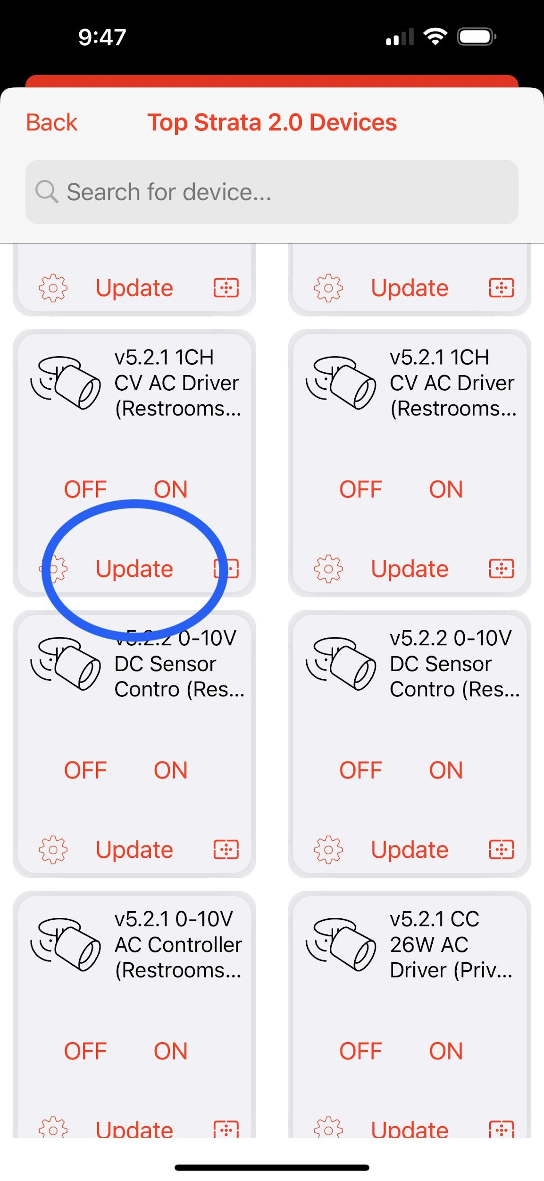
Warranty
Hardware failure rate is: 0.3%
Standard warranty is 2 years with optional 5 years.
Software can be updated over-the-air.

Slide 24
Thank you

